Slide 1
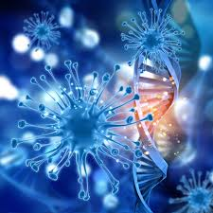
HAIR AND BEAUTY SCIENCE. By ---------------

Slide 2
Task 1a (GD-1b) Pass - specific Ingredients in 2 hair & 2 Beauty products.
Hair & Beauty Products | Ingredients | Properties
Hair Product GHD Curl Hold Spray
Hair Product AVEDA Invati Exfoliating Shampoo,
Beauty Product DOVE beauty cream
Beauty Product LUSH Enchanted Eye Cream

Slide 3
Task 1b (GD 1c pass) Outline and examine the effects of the two hair and two beauty products that they have on the hair and skin.
Ingredient | Effects
Hair Product GHD Curl Hold Spray
Hair Product AVEDA Invati Exfoliating Shampoo,
Beauty Product DOVE beauty cream
Beauty Product LUSH Enchanted Eye Cream

Slide 4
Task 1c (GD 1b&1c merit) Refer back to the ingredients from each product and describe the functions of one ingredient from each product.
Describe the effect that your chosen ingredients have on the hair and skin.
Ingredient | Function and Effects

Slide 5
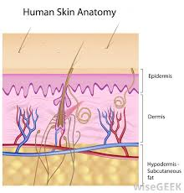
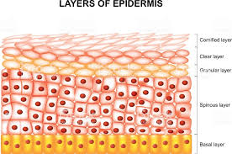
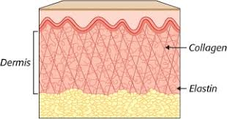
Learning outcome 2 - Task 2a GD-2a pass) Describe the outline of the basic skin structure.
Epidermis | Dermis | Hypodermis

Slide 6
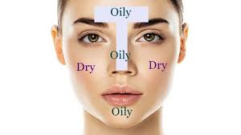
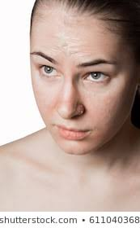
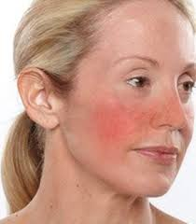
Task 2b ( GD-2b pass) Describe the main characteristics of skin types and conditions
Combination | Dehydrated | Sensitive

Slide 7
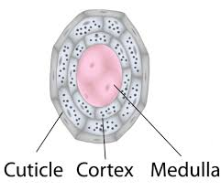
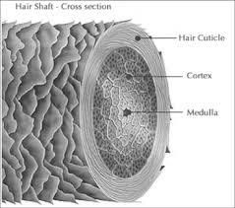
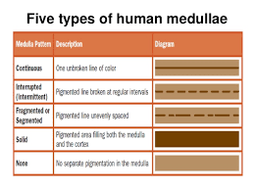
Task 2c ( GD-2c pass) outline the basic structure of the hair.
Cortex | Cuticle | Medulla

Slide 8
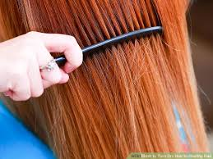
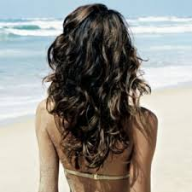
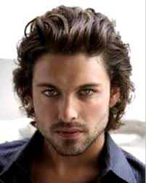
Task 2d ( GD-2d pass) state the main characteristics of the following hair types.
Dry Hair | Environmentally Damaged Hair | Virgin Hair

Slide 9
Task 2e ( GD-2a and 2b Merit) Describe the basic structure of the skin.
Epidermis | Dermis | Hypodermis

Slide 10
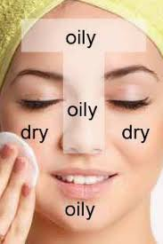
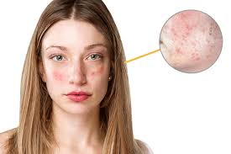
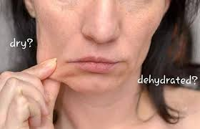
Task 2e ( GD-2a and 2b Merit) Describe the main characteristics of skin types and conditions
Combination | Dehydrated | Sensitive

Slide 11
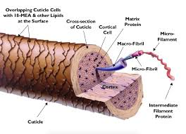
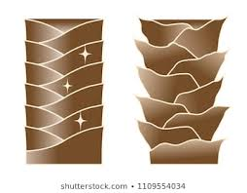
Task 2f( GD-2c and 2d Merit) Describe the basic structure of the hair
Cortex | Cuticle | Medulla

Slide 12
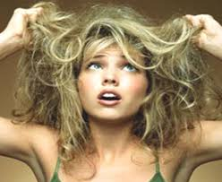
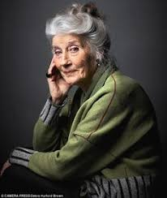
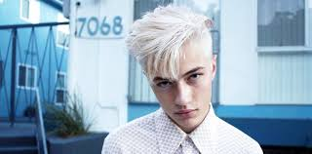
. Task 2f( GD-2c and 2d Merit) Describe the main characteristics of hair types.
Dry Hair | Environmentally/ Damaged Hair | Virgin Hair

Slide 13
Design 1 hair or 1 beauty product.

Slide 14
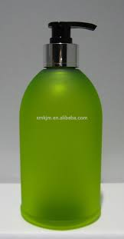
Task 3a (GD-3a pass) You now have knowledge of different ingredients and the effects.
Design your own product formula for hair
Hair Product -
Key Ingredients -
Desired Effects on the hair -

Slide 15
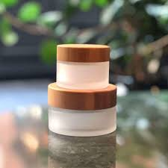
Task 3a (GD-3a pass) You now have knowledge of different ingredients and the effects.
Design your own product formula for beauty.
Beauty Product -
Key Ingredients -
Desired Effects on the skin-

Slide 16
Task 3b (GD-3b merit)
HAIR
Describe why have you chosen these ingredients in your product formulation-
Describe the benefits your formulation has on the hair.

Slide 17
Task 3b (GD-3b merit)
BEAUTY
Describe why have you chosen these ingredients in your product formulation-
Describe the benefits your formulation has on the skin.

Slide 18
Task 3C (GD-3a Distinction) Justify the product formulation.
Justification of specific ingredients Hair-
Compatibility-
Stability-
Preservation-
Effectiveness-

Slide 19
Task 3C (GD-3a Distinction) Justify the product formulation.
Justification of specific ingredients Beauty-
Compatibility-
Stability-
Preservation-
Effectiveness-

